Slide 1


Analyze Promotions And Provide Tangible Insight
By Rumpi Das

Slide 2

Problem Statment
AtiQ Mart recently conducted a massive promotion across all 50 of their stores during the Diwali 2023 and Sankranti 2024 festivals. Now, the sales director is eager to understand which promotions performed well and which ones did not. The goal is to make informed decisions for their next promotional period.

Slide 3
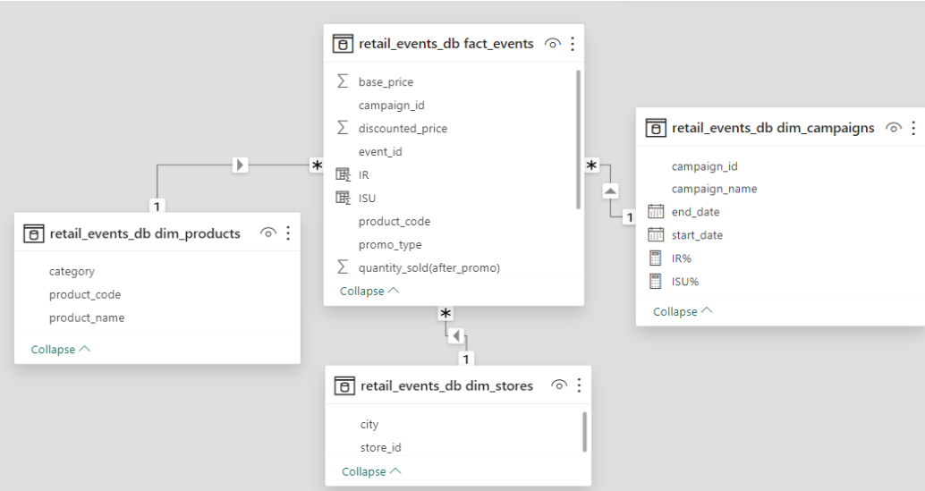

Datasets overview

Slide 4
Objectives
To address this challenge, my project aimed to leverage the information from fact_events, dim_product, dim_store, and dim_campaign to analyze sales data during the Diwali 2023 and Sankranti 2024 promotional periods.
This analysis will provide insights into the success and areas for improvement, enabling AtliQ Mart to make data-driven decisions for their future promotions.

Slide 5


Campaigns
Diwali

Slide 6



Promo Offers
RS.500 Cashback
33% Off
25% Off

Slide 7
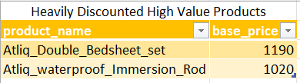
1 . Provide a list of products with a base price greater than 500 and that are featured in promo type of 'BOGOF' (Buy One Get One Free). This information will help us identify high-value products that are currently being heavily discounted, which can be useful for evaluating our pricing and promotion strategies.
Business Request

Slide 8
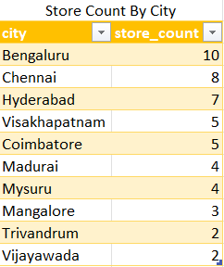
2. Generate a report that provides an overview of the number of stores in each city. The results will be sorted in descending order of store counts, allowing us to identify the cities with the highest store presence. The report includes two essential fields: city and store count, which will assist in optimizing our retail operations.
Business Request

Slide 9

3 . Generate a report that displays each campaign along with the total revenue generated before and after the campaign? The report includes three key field: campaign_name,total_revenue(before_promotion),total_revenue(after_promotion). This report should help in evaluating the financial impact of our promotional campaigns. (Display the values in millions)
Business Request

Slide 10
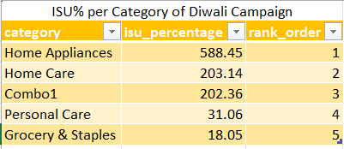
Q4. Produce a report that calculates the Incremental Sold Quantity (ISU%) for each category during the Diwali campaign. Additionally, provide rankings for the categories based on their ISU%. The report will include three key fields: category, isu%, and rank order. This information will assist in assessing the category-wise success and impact of the Diwali campaign on incremental sales.
Business Request

Slide 11

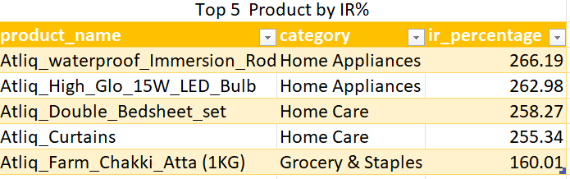
Q5. Create a report featuring the Top 5 products, ranked by Incremental Revenue Percentage (IR%), across all campaigns. The report will provide essential information including product name, category, and ir%. This analysis helps identify the most successful products in terms of incremental revenue across our campaigns, assisting in product optimization.

Slide 12
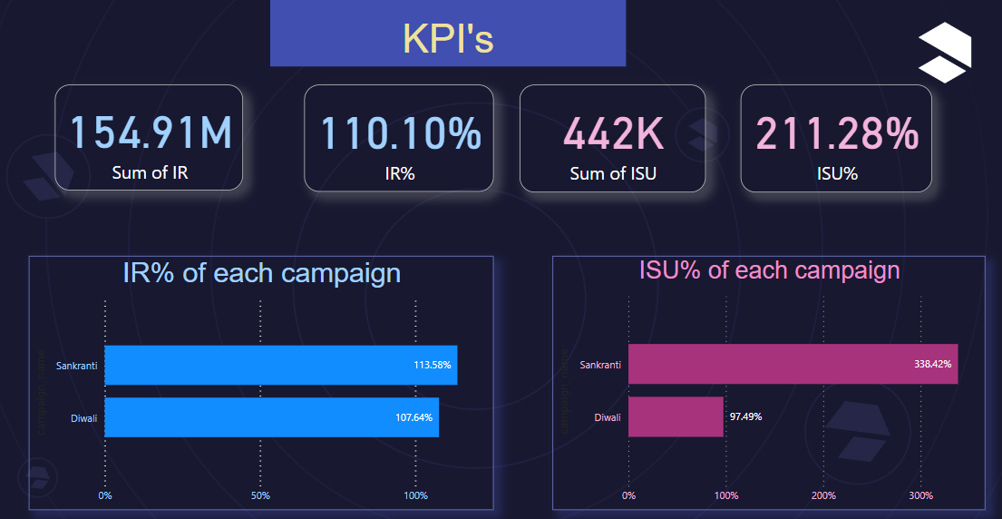
IR = Incremental revenue. IR% = Incremental revenue% increase/decrease as compare to before promo. ISU = Incremental Sold Unite. ISU% = Incremental sold unit% as compare to before promo.
Dashboard
Key metrics
Insights
Our Diwali campaign shines with a remarkable 107.49% Incremental Revenue (IR), driven by an impressive 97.49% Incremental Sold Units (ISU). This synergy underscores the effectiveness of our Diwali strategies, showcasing a substantial boost in both revenue and sold units.
Turning the spotlight to Sankranti, our campaign achieves a staggering 113.58% Incremental Revenue (IR) with an astonishing 338.42% Incremental Sold Units (ISU). This exceptional performance not only signifies increased revenue but also an unprecedented surge in sold units, highlighting the tremendous success of our Sankranti promotions.

Slide 13
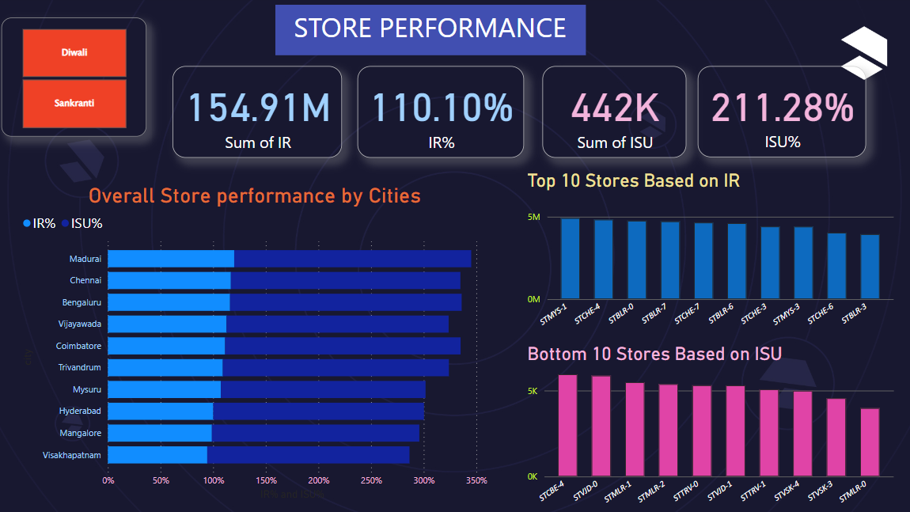
The overall store performance remains the same across each city. This stability in performance suggests a well-balanced retail strategy and operational efficiency.
Dashboard
Insights
Madurai, Chennai and Bengaluru are the top three cities in terms of store performance. This insight provides strategic direction, allowing us to allocate resources and tailor our initiatives to maximize success in these key cities.

Slide 14
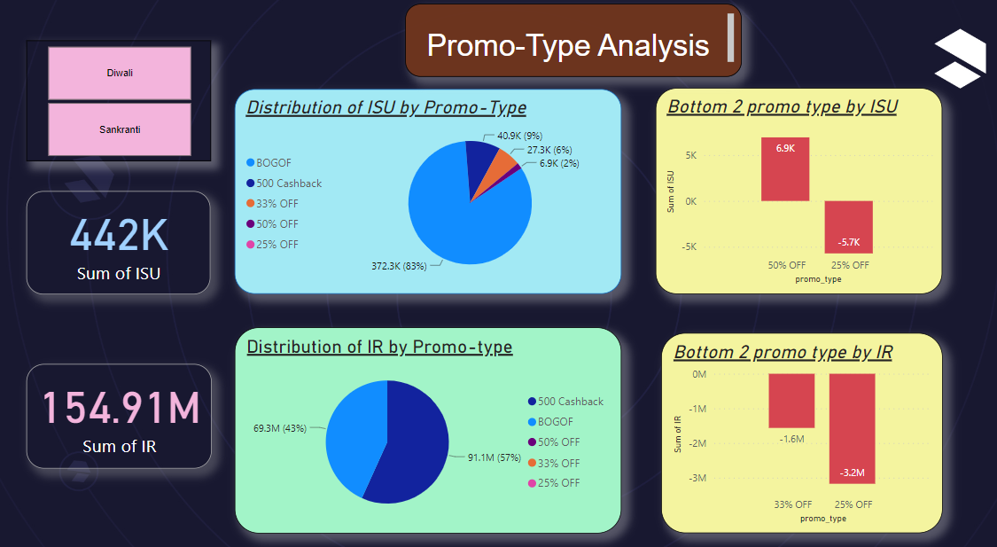
Dashboard
Insights
BOGOF generates the highest ISU, at around 83%, and it generates an IR of approximately 43%.
For the 500 Cashback promotion, it generates an ISU of 9% and an IR of 57%.
50% off and 25% off promotions generate the lowest ISU.
33% off and 25% off promotions generate the lowest IR.
500 Cashback and BOGOF promotions capture the entire IR.

Slide 15
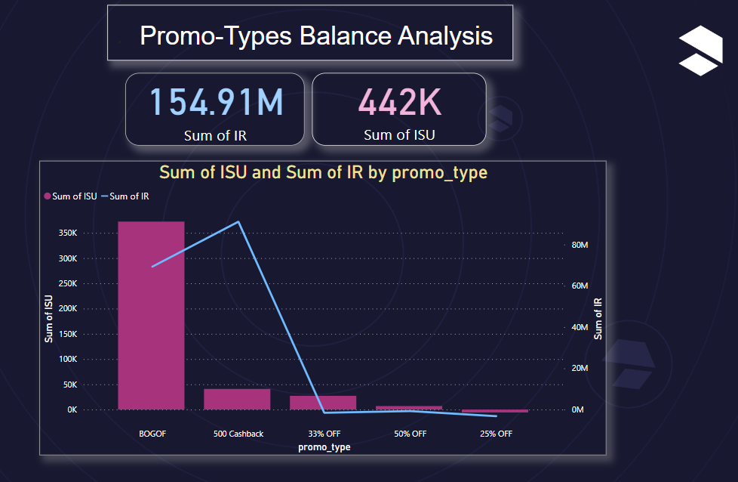
Dashboard
Insights
This visual representation allows us to identify which promotions strike the optimal balance between increasing sales units and generating additional revenue. From the graph, we can see that 500 Cashback strikes the best balance between ISU and IR.

Slide 16
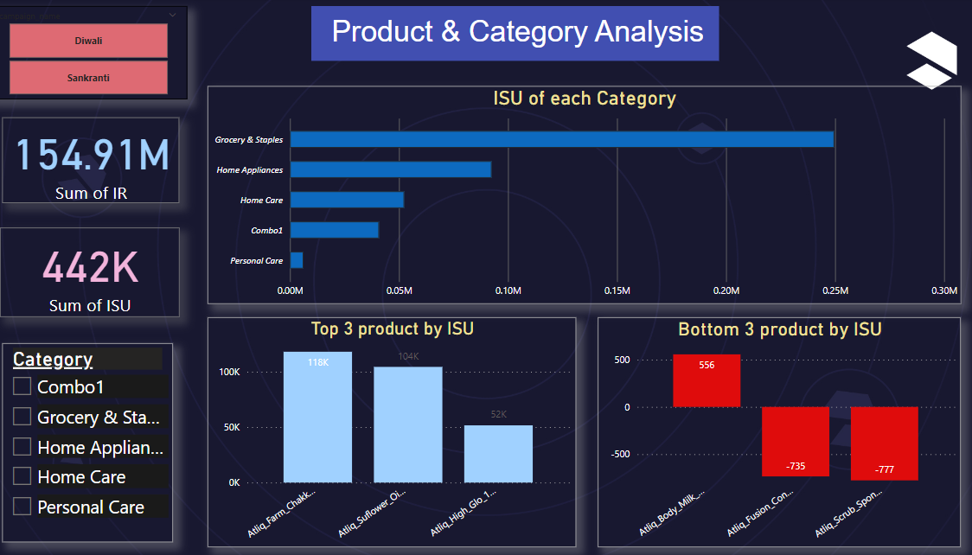
Dashboard
Insights
The product category Grocery & Staples saw the most significant lift in sales from the promotions.
Atliq Farm Chakki Atta(1kg), Atliq Sunflower oil and Atliq High Glo 15W LED Bulb respond exceptionally well to promotions.
Atliq Body Milk Nourishing Lotion(120ml), Atliq Fusion Container Set of 3 and Atliq Scrub Sponge For Dishwash respond exceptionally poorly to promotions.

Slide 17
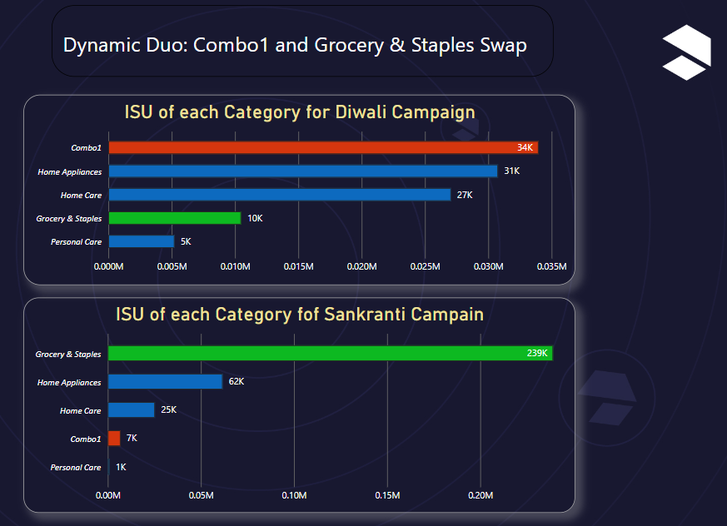
In the Diwali Campaign, Combo1 takes the lead, generating the highest Incremental Sold Units (ISU). In the Sankranti Campaign, Grocery & Staples steal the spotlight, showing the highest ISU. Across the two campaigns, Combo1 and Grocery & Staples gracefully swap positions, revealing the dynamic nature of their impact on our sales strategy.
Dashboard
Insights

Slide 18
Findings & Implications
According to store performance, Madurai holds the highest position. But there are only 4 stores in the city.
BOGOF however helped in increasing the sale unit but it did not increase the Incremental Revenue to that extent. In view of this, the 500 cashback promotion has increased the Incremental Revenue by a large amount.
The sale volume of the Home Essential Combo product has increased manifold during Diwali. So it can be said that the demand for this product is highest during Diwali.
Sales of Grocery & Staples are seen to increase manifold during Sankranti. So it can be said that the demand for this product is highest during Sankranti.
If we want to increase more stores then new store should be built in Madurai.
We have to focus on 500 cashback offer as it is generating most Incremental Revenue.
During Diwali we can focus on sales of Home Essential Combo products.
During Sankranti we can focus on the sales of Grocery & Staples.

Slide 19
Conclusion
Thank you for joining me on this data-driven journey through AtliQ mart's promotions. Let's apply these insights to optimize our strategies. Remember, data empowers decisions. Here's to continuous improvement and success.
If you have any questions or thoughts, I welcome them now. Let's embark on this journey of growth and success together. Thank you."

